Slide 1
Wednesday 21 April 2021
9:30am - 6pm
www.skillsengland.co.uk
@SkillsEngland #SkillsHumber
Organised by

Slide 2
What is
SkillsHumber is using an online platform to give you access to a diverse range of employers, training providers, apprenticeships, and further education providers. They will be available on their booths to speak with you, answer questions, and provide information and guidance around your future career.
@SkillsEngland #SkillsHumber
Organised by

Slide 3
What to expect at
Exhibitor booths
Every booth has a chat button, and downloadable resources.
Skills Theatre
Exciting range of presentations, with live question and answer sessions.
Live Opportunities
A listing of current vacancies, traineeships and apprenticeships.
Video Vault
Vault store for all videos from the event.
Resources
Full listing of all downloadable content.
Swag Bag
Collect downloads into a Swag Bag. Please note if using a group sign on, only one Swag Bag will be available. You can open your bag at any time and email content to your preferred email address. To have a personal Swag Bag you will need to register independently.
30 Day Platform access
You can log back in anytime in the 30 days following the live event to access more information or visit different exhibitors.
Organised by

Slide 4
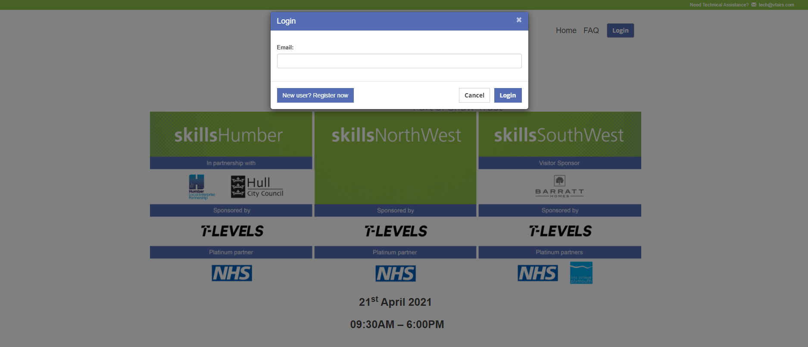
Accessing - Login
The link provided will take you to the event landing page
www.skillsshows.vfairs.com
Select Login
Then enter the email address that was used to register for the event.
Organised by

Slide 5
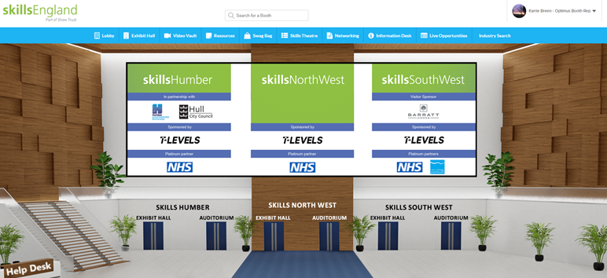
Accessing – Main Lobby
From the main lobby you access your regional show by clicking on the named doors.
There is also a navigation bar along the top which takes you directly to the areas shown.
The help desk will always be staffed so please just select this if you have any issues.
Organised by

Slide 6
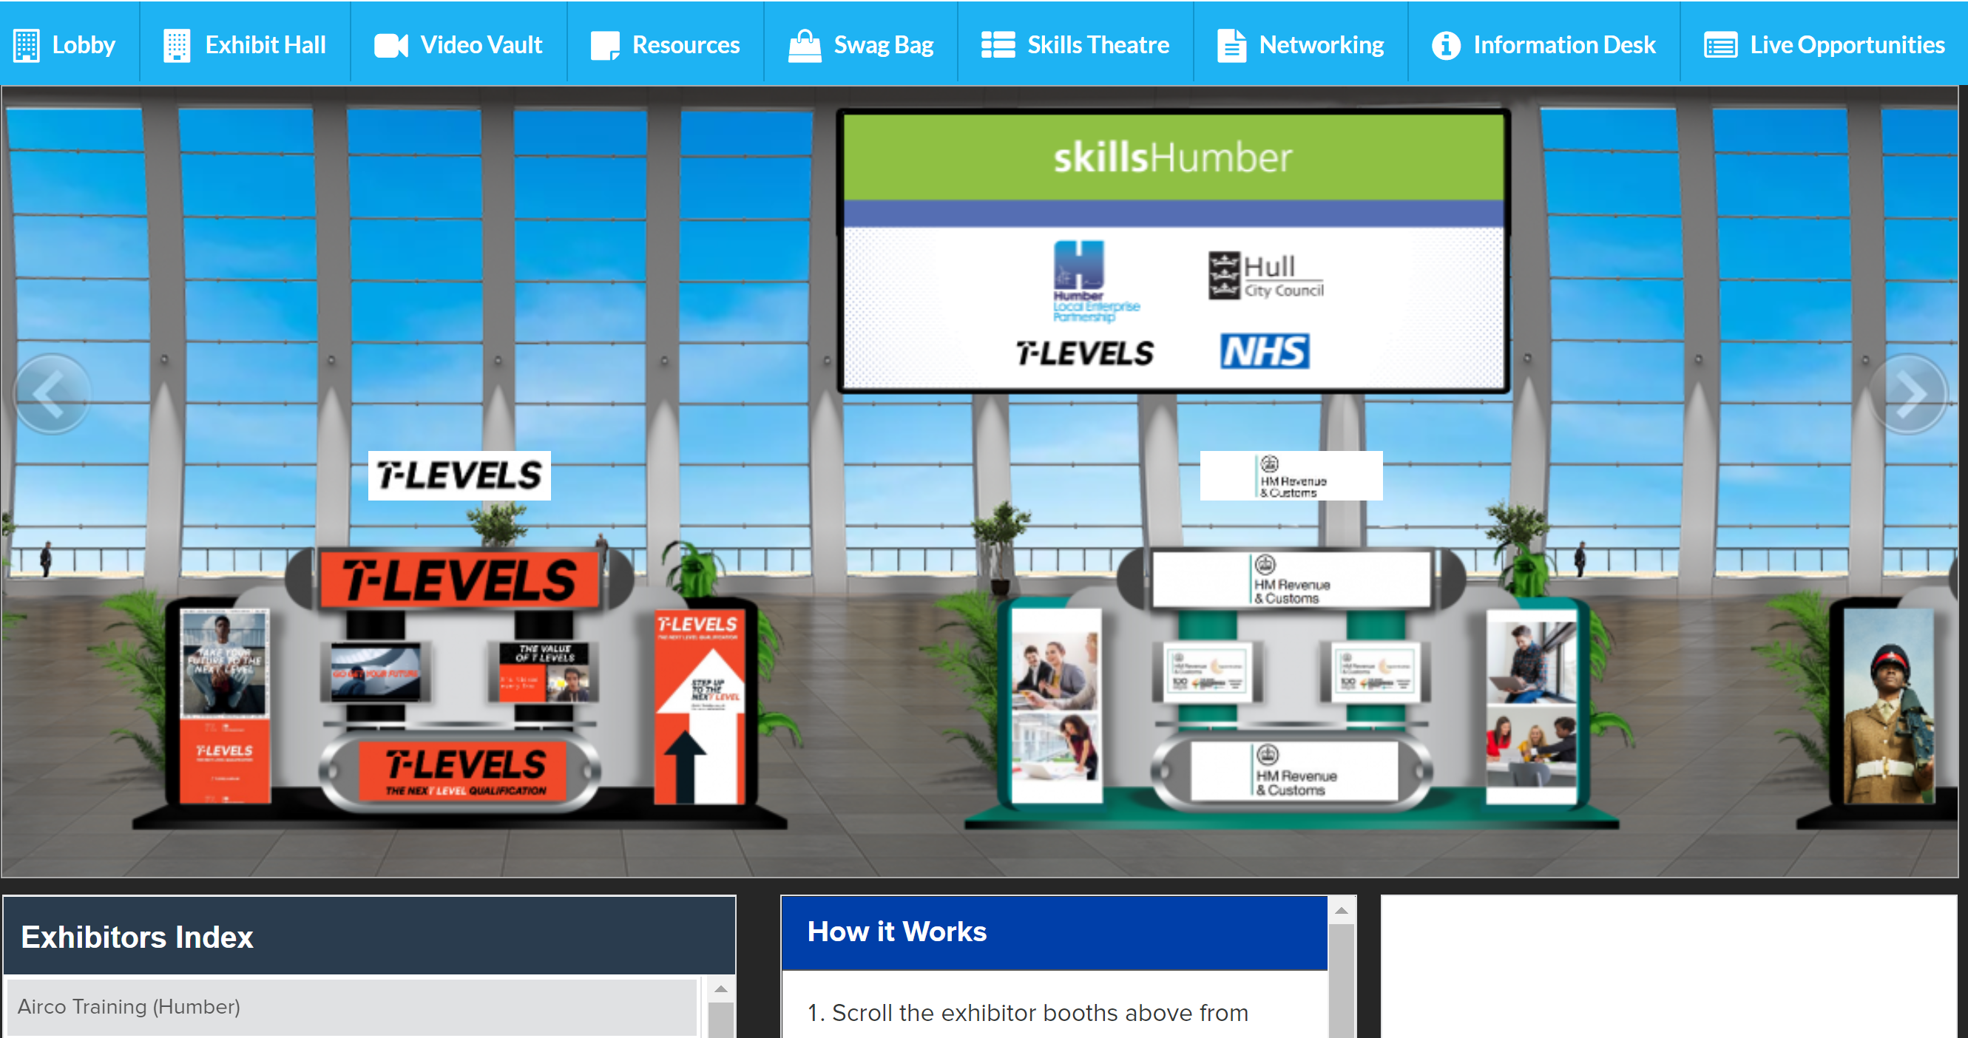
Accessing – Exhibition Hall
Once in the exhibition hall you can select booths to visit by either scrolling along the hall or selecting from the Exhibitor Index. Simply click anywhere in the booth area to access further information.
Reminders on how to use the site are also shown on this page.
The Skills Theatre listing will also be shown on this page.
Organised by

Slide 7
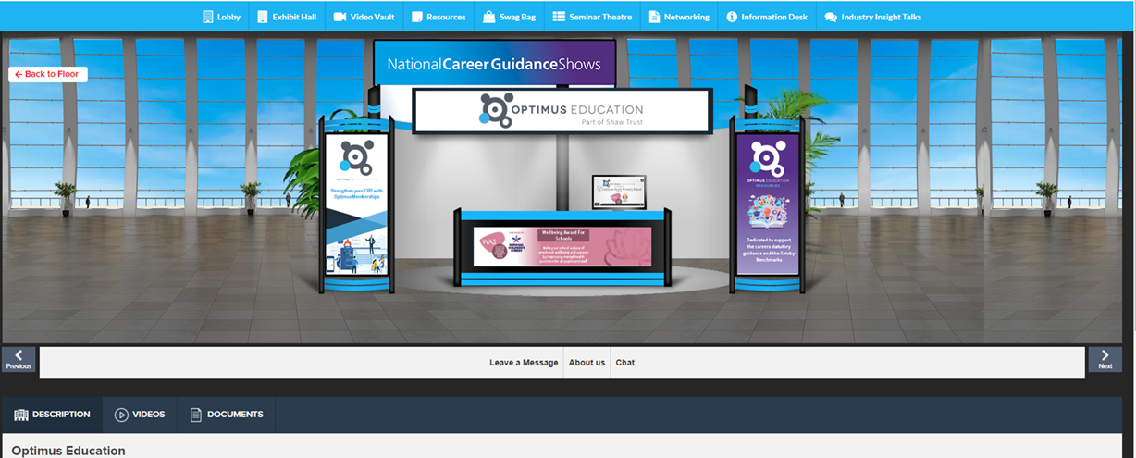
Accessing – Visiting a Booth
Having selected a booth to visit, you can access more information either by clicking on the panels, or by using the dropdown menu under the booth visual.
You can download any resources to your Swag Bag to look at later.
Please take time to speak with exhibitors. To do this just click the ‘Chat’ button on the search bar and you will enter the chat room and one of the team will be able to answer questions.
If you don’t have time to chat but you would like to ask a question, click the ‘Leave a Message’ button to submit you question and someone will come back to you.
To move to another stand, use either the ‘Back to Floor’ button or the ‘Next’ and ‘Previous’ buttons under the booth.
Organised by

Slide 8
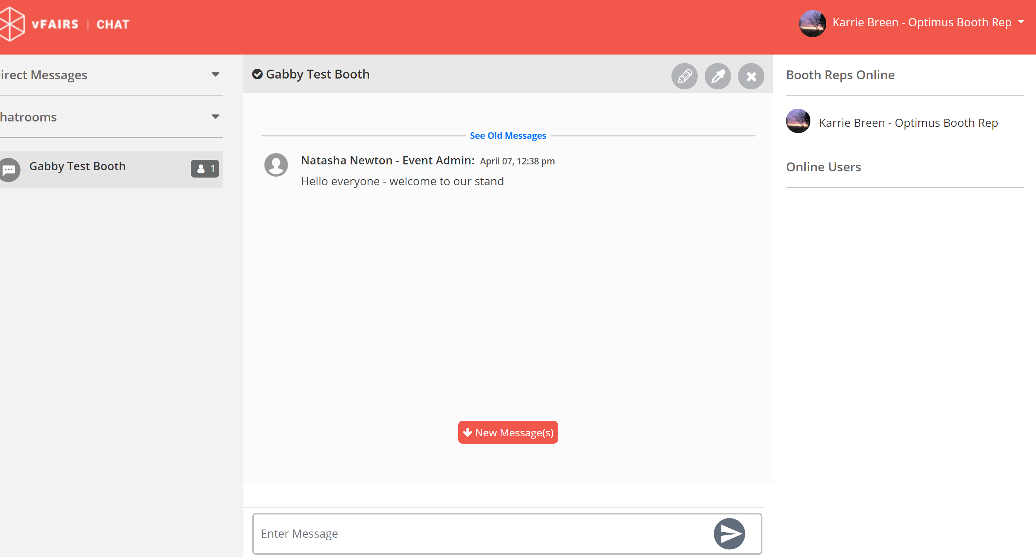
Accessing – The Chat Room
Once you enter the chat room this is what you will see. The exhibitors will see you are there and either you or they can start the conversation.
You are in a public chat room at this time, and anyone else who enters the chat room can see your conversation. For more in-depth or longer conversations it can be better to have a direct chat with the exhibitor which they may offer.
Exhibitors may ask for your email address so they can send you more information and follow up on your conversations.
Organised by

Slide 9
Preparing for your visit to
Think about your next steps:
Do I want to stay in education?
Do I want to go to sixth form, college or university?
Do I want to go into an apprenticeship, a job with training or a traineeship, or a T Level qualification?
Do I want to start my own businesses one day?
Should I volunteer alongside my studies?
Do I know what qualifications I need to achieve my career goals?
Have I thought about the type of career I want?
What have I based my career decisions on?
Do I know what opportunities are out there for me?
Organised by

Slide 10
Preparing for your visit to
Think about questions to ask exhibitors, they are all here to help and give advice to help you make the best possible choices, there are no silly questions:
Do you have apprenticeships?
What careers/courses do they offer?
What qualifications do I need?
How much can I earn?
As a ??? what is a typical day like?
What are the progression opportunities?
How do I apply?
Are there opportunities to work abroad?
Do you have opportunities across the UK?
How diverse is your workforce at all levels?
Do you offer work experience?
Organised by

Slide 11
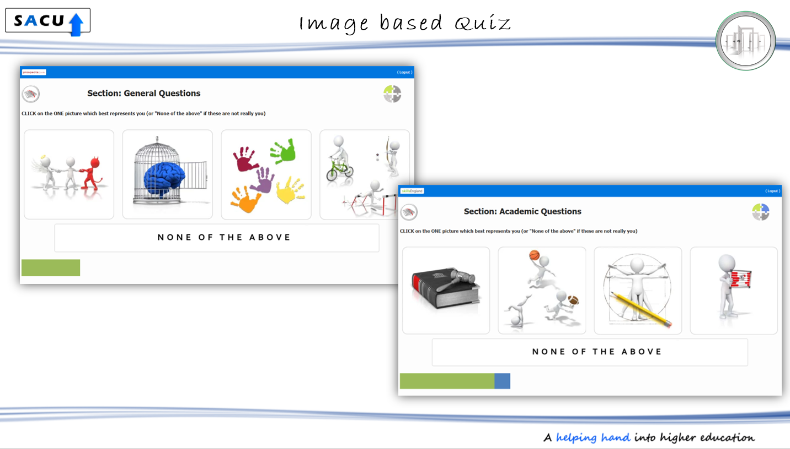
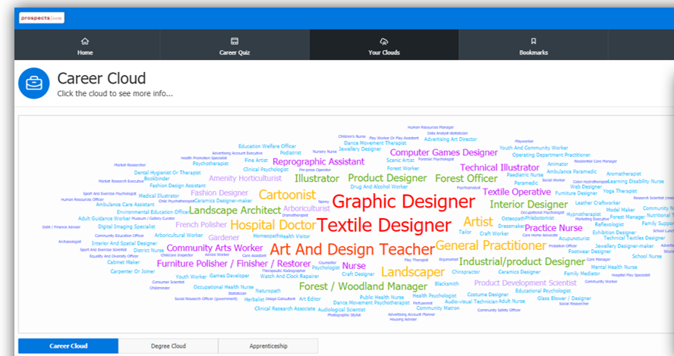
Need some ides on what career is for you?
In partnership with SACU, you have free of charge access to a fantastic online career quiz. It is an imaged quiz which at the end produces your personalised career cloud. Why not take the quiz before you attend the event to help guide you on which exhibitors to contact. You can access the quiz at www.sacu-student.com/skills
Organised by

Slide 12
More access to
The event is open until 6pm on the live day (Wednesday 21 April) and 30 days after the live day.
You can use the same link and login outside of school hours.
You can also register independently using the below link .
Plan to revisit the show with your parents/carers and show them the careers that interest you.
From 4pm-6pm on the live day, video chat with exhibitors will also be available.
Share the information about the show with your friends and family so we can support as many people as possible with future careers.
www.skillsshow.vfairs.com
Organised by

Slide 13
– Frequently Asked Questions
Do I need to download or install any information to be able to attend this event?
No. You do not need to download or install any software to participate. You only need to have access to the internet.
Can I find out what companies will be there?
For a full list of exhibitors go to our website at www.skillsengland.co.uk
What should I do if I have trouble logging in?
Email vFairs technical assistance team at skillsshows@getvfairs.io
Do I need to register to participate in the virtual event?
Yes, you will need to use register via Eventbrite Skills North West – HERE Skills Humber – HERE Skills South West – HERE
Can I revisit the event if I log out
Yes, you simply log back in. The event is accessible for 30 days after the live day with the exception of live Q&A sessions
Organised by

Slide 14
SOME OF OUR EXHIBITORS AND SPONSORS
@SkillsEngland #SkillsHumber
Organised by

